Slide 1
September 20, 2023
Robberto, Smee, Barkhouser, Koeppe, Piotrowski, Hammond

Slide 2
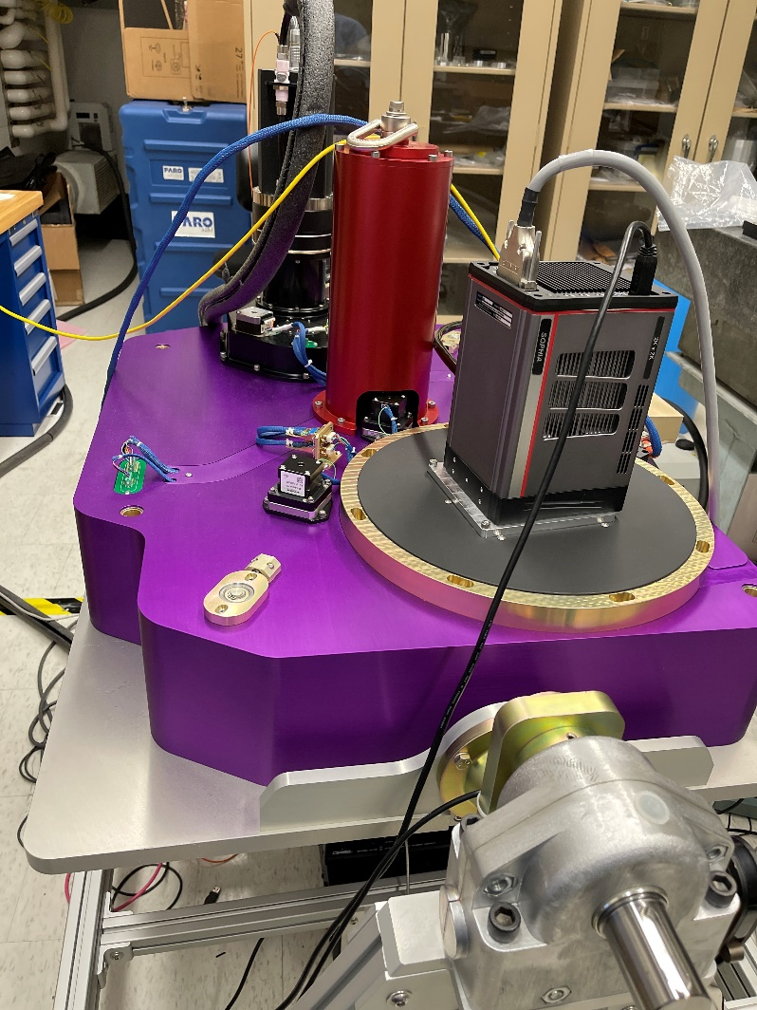
SAMOS Timeline
SAMOS in IDG Lab @ JHU
NSF Funds awarded 2016
PDR completed March 2018
Hardware complete ~ 2021/2022
Software complete 2023
AIT complete August 2023
Pre-Ship Review September 20, 2023

Slide 3
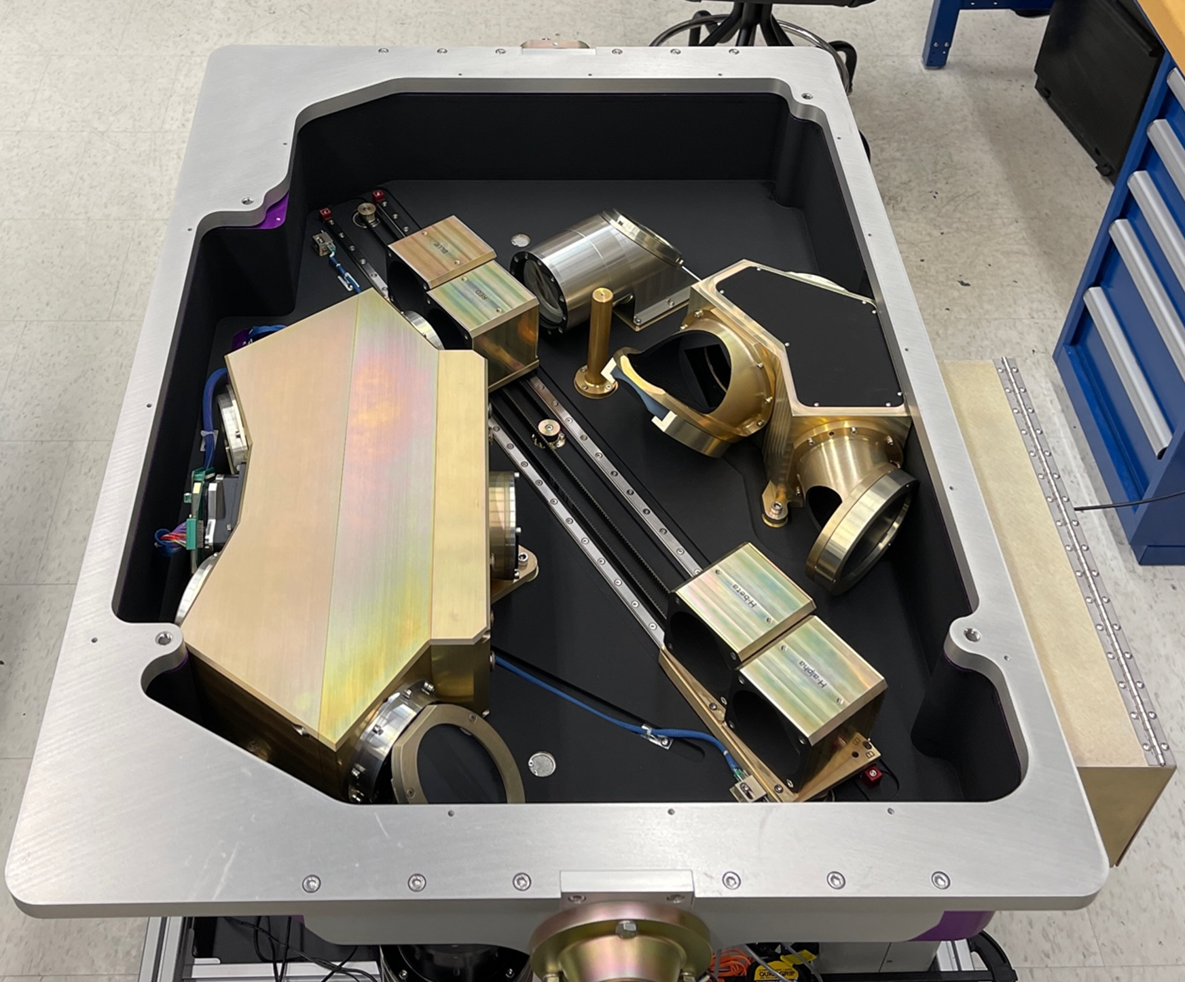
Pre-Ship Review Agenda
Optomechanical Compliance
Optical Performance
Mechanical Performance
Packaging and Shipment Plan
Lab activities/schedule at SOAR
Commissioning activities/schedule

Slide 4
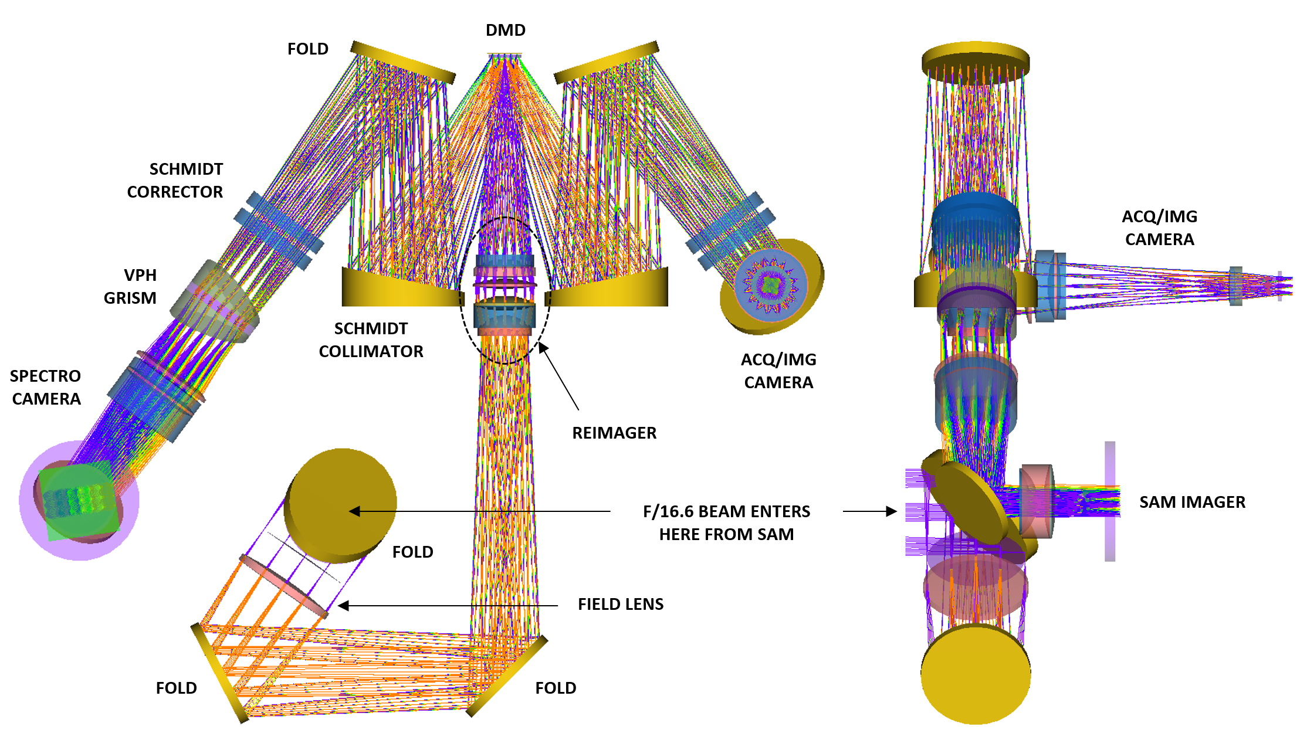
The Optomechanics
The SAMOS uses a highly folded optical layout containing numerous reflective, refractive, and diffractive optics
All optics are mounted by dead-reckoning, (i.e. without adjustment) but for focus shims at the reimager, DMD, and CCDs.
Optics (lenses, mirrors, prisms) were fabricated by Optimax
Gratings were fabricated by KOSI
Optomechanical components fabricated by JHU IDG.

Slide 5
Optical Element Metrology
Optimax provided full inspection reports with each optic.
JHU verified all lens diameters prior to installation. Thicknesses were verified at the assembly level to verify vertex-to-vertex spacings.
In all cases, JHU measurements agreed with Optimax inspection reports.
By all appearances, Optimax did a fantastic job fabricating the SAMOS optics.

Slide 6
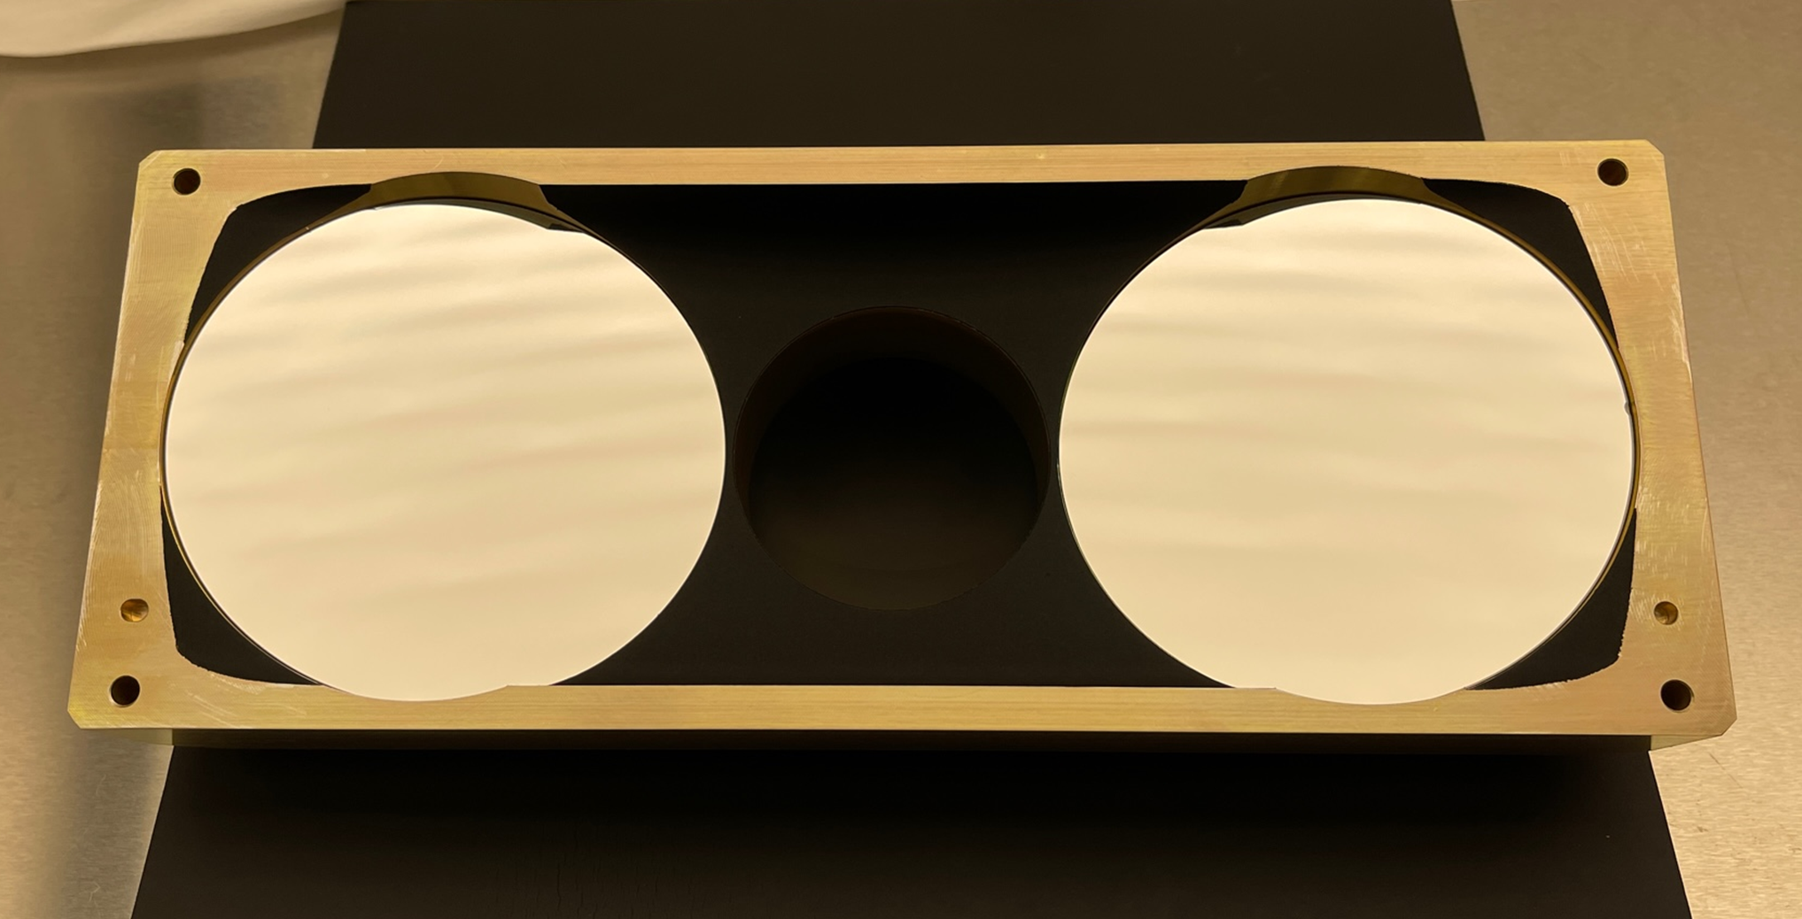
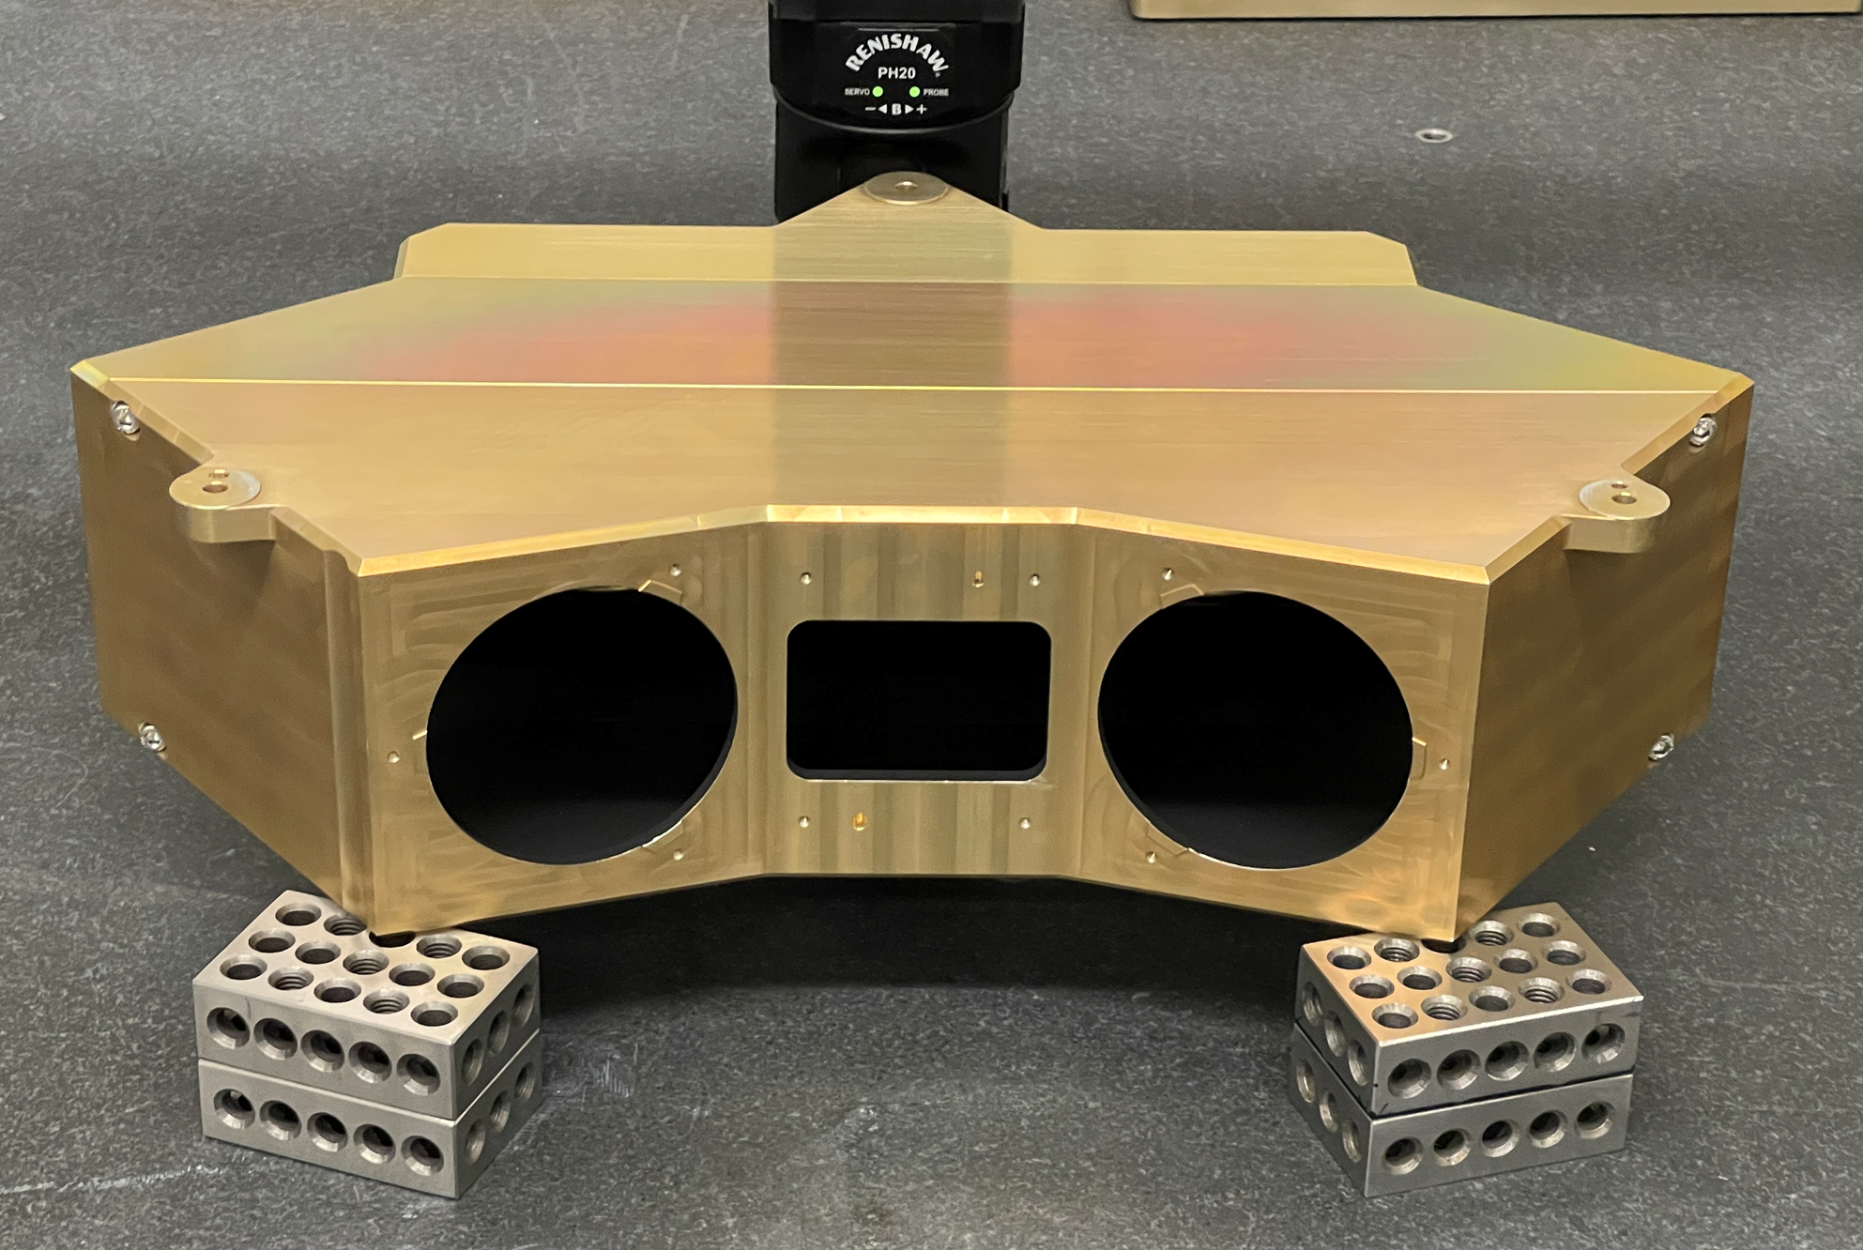
Optomechanical Metrology
JHU measured all lens diameters to verify compliance
In particular radial clearance required to ensure decenter tolerance compliance
Clearance required for cold survival limit (-20 °C)
CMM measurements of Schmidt collimator surface (outside CA) to verify segment alignment.
Results indicate that both segments are within tolerance
CMM measurements of Schmidt housing indicate that all optomechanical reference features are extremely accurate
Schmidt fold and corrector interfaces are accurate to 0.002 degrees.
Reference hole (dowels and bores) true positions good to 50 um.

Slide 7
Optomechanical Metrology Cont.
Optical bench reference features measured in various ways.
On the CNC machine during final machining.
Using FARO arm upon completion.
Optomechanical system alignment verified optically.
Central pinhole at the field stop location falls within 90 um of DMD center!
Placement tolerance of the DMD die in the package is 150 um.
DMD image is centered on the imaging channel CCD to within 14 pixels
Grism alignment is very good.
All spectra are aligned to the spectral channel CCD pixels to better than +/- 2 pixels (13 um per pixel on the Sophia test camera) over the spectral range
Need to check how well the central wavelength falls on the detector.

Slide 8
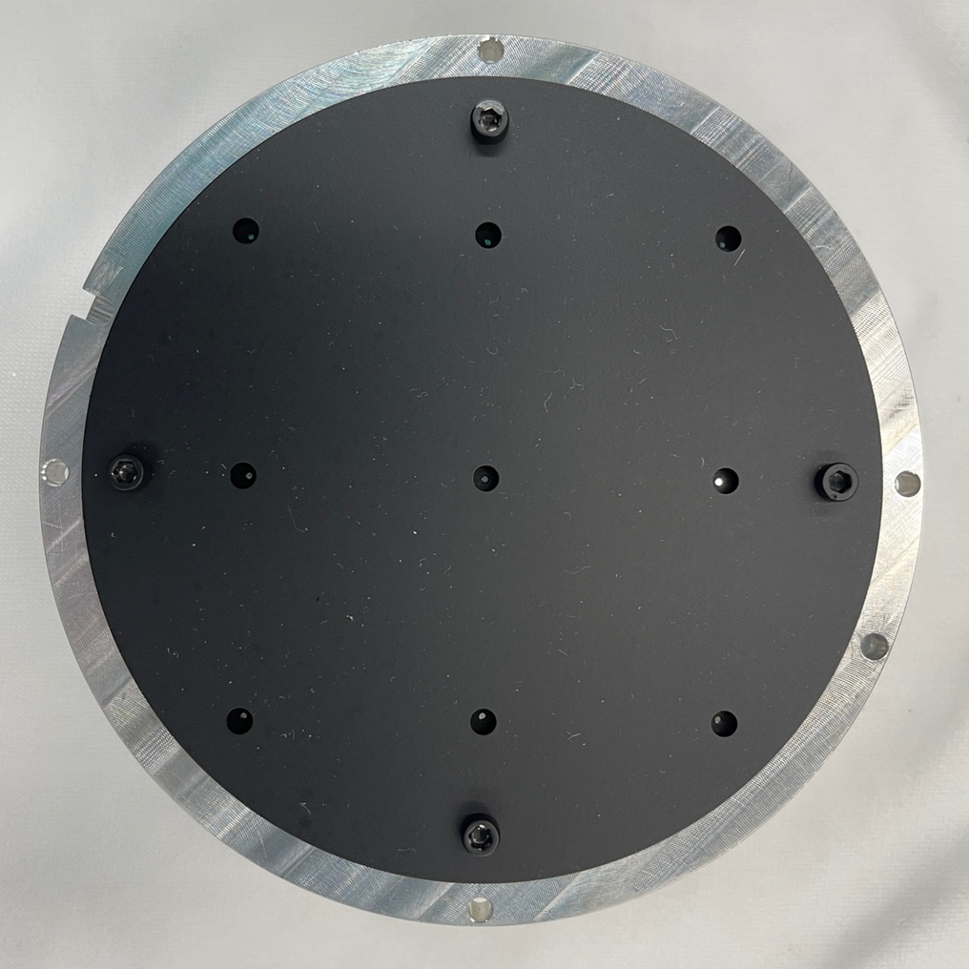
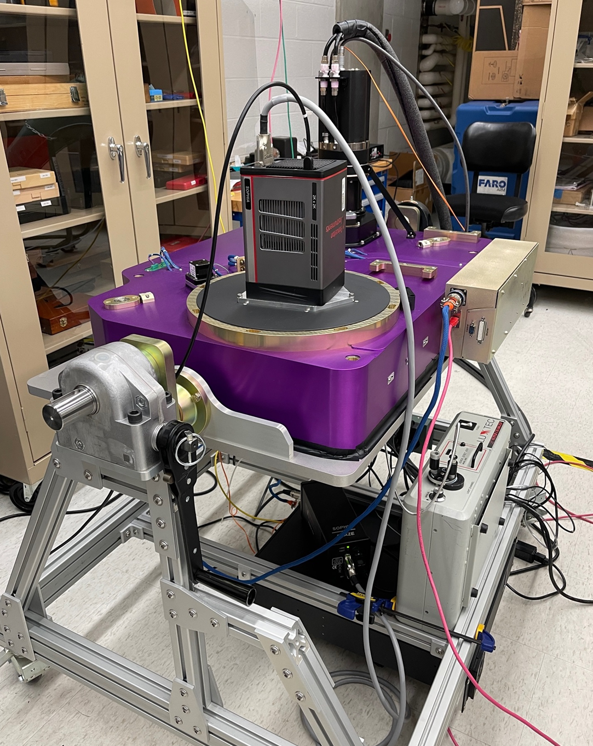
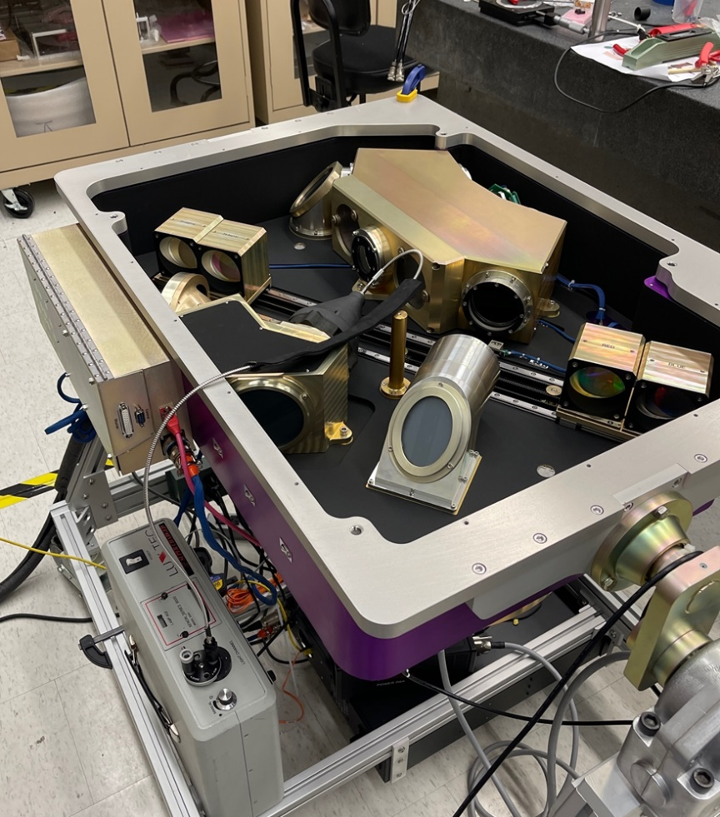
Optical Performance Test Setup
Fiber fed pinhole projector
Spectral Instruments SI850 CCD camera, 1k x 1k, 13um pixels
Spec Channel Camera, for test only
(Teledyne Sophia blue sensitive CCD, 2k x 2k)
Xenon Source
(Also use Halogen and Hg line source)
Fiber

Slide 9
Optical Performance: DMD/Imaging Channel z-Band
Required FWHM @ DMD: 14.0 μm
Achieved FWHM @ DMD: 7.77 μm
Required FWHM @ CCD: 0.30 arc-sec
Achieved FWHM @ CCD: 0.25 arc-sec

Slide 10
Optical Performance: DMD/Imaging Channel i-Band
Required FWHM @ DMD: 14.0 μm
Achieved FWHM @ DMD: 7.82 μm
Required FWHM @ CCD: 0.30 arc-sec
Achieved FWHM @ CCD: 0.23 arc-sec

Slide 11
Optical Performance: DMD/Imaging Channel r-Band
Required FWHM @ DMD: 14.0 μm
Achieved FWHM @ DMD: 8.38 μm
Required FWHM @ CCD: 0.30 arc-sec
Achieved FWHM @ CCD: 0.24 arc-sec

Slide 12
Optical Performance: DMD/Imaging Channel g-Band [1 of 2]
Required FWHM @ DMD: 14.0 μm
Achieved FWHM @ DMD: 21.77 μm
Required FWHM @ CCD: 0.30 arc-sec
Achieved FWHM @ CCD: 0.29 arc-sec

Slide 13
Optical Performance: DMD/Imaging Channel g-Band [2 of 2]
1x1 micromirror ensquared energy reduced by PSF decentered on micromirror
Required FWHM @ DMD: 14.0 μm
Achieved FWHM @ DMD: 21.77 μm
Required FWHM @ CCD: 0.30 arc-sec
Achieved FWHM @ CCD: 0.29 arc-sec

Slide 14
Optical Performance: DMD/Imaging Channel Halpha
Required FWHM @ DMD: 14.0 μm
Achieved FWHM @ DMD: 8.05 μm
Required FWHM @ CCD: 0.30 arc-sec
Achieved FWHM @ CCD: 0.28 arc-sec

Slide 15
Optical Performance: Scattered Light z-Band
Total scattered power: 1.45%

Slide 16
Optical Performance: Scattered Light i-Band
Total scattered power: 1.45%

Slide 17
Optical Performance: Scattered Light r-Band
Total scattered power: 1.25%

Slide 18
Optical Performance: Scattered Light g-Band
Total scattered power: 0.97%

Slide 19
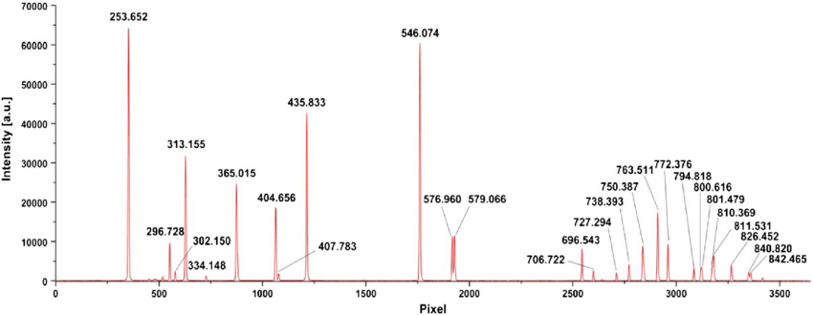
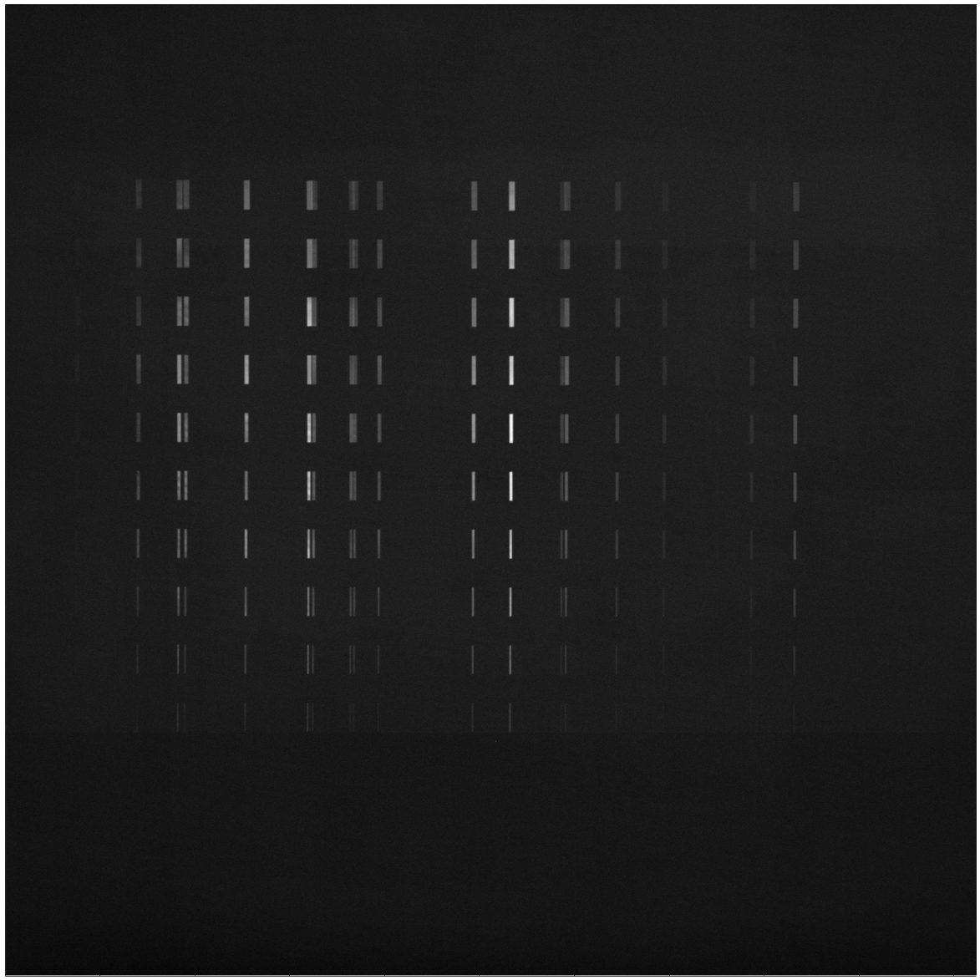
Optical Performance: Mercury-Argon Calibration Source
10 micromirror slit
9 micromirror slit
.
.
.
.
.
.
.
1 micromirror slit

Slide 20
Optical Performance: Line Source Resolution
810.4/811.5 nm
840.8/842.5nm
800.6/801.5 nm
750.4/751.5 nm
866.8 nm
852.1 nm
794.8 nm
772.4 nm
738.4 nm
727.3 nm
714.7 nm
706.7 nm
826.5nm
763.5nm
696.5 nm
5 micromirror slit
170 nm
230 nm

Slide 21
Optical Performance: Blue Grism Resolution
546 nm
2.5 pixel FWHM
436 nm
2.5 pixel FWHM

Slide 22
Optical Performance: Red Grism Resolution
Point source
764 nm
3 pixel FWHM
865 nm
1.5 pixel FWHM
697 nm
2 pixel FWHM

Slide 23
Optical Performance: Contrast Ratio [1 of 2]
JWST contrast requirement > 2000:1

Slide 24
Optical Performance: Contrast Ratio
Fringes from UV-optimized
test camera reduces the
measured contrast
JWST contrast requirement > 2000:1

Slide 25
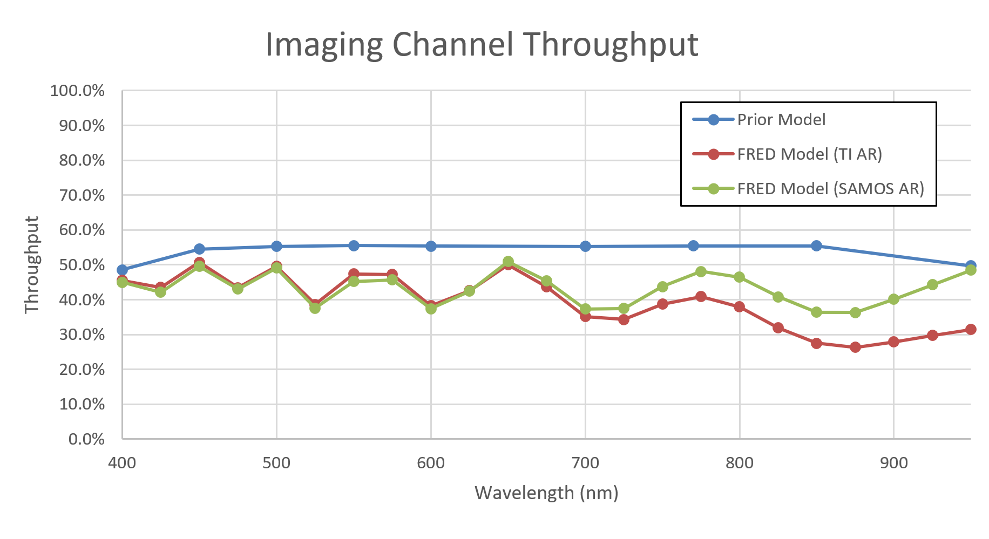
Optical Performance: Predicted Throughput Imaging Channel
Based on current stock DMD AR coating

Slide 26
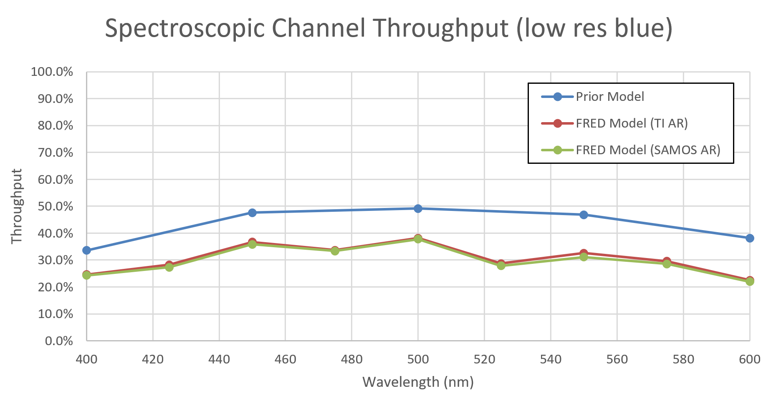
Optical Performance: Predicted Throughput Spectroscopic Channel Low-Res Blue
Based on current stock DMD AR coating

Slide 27
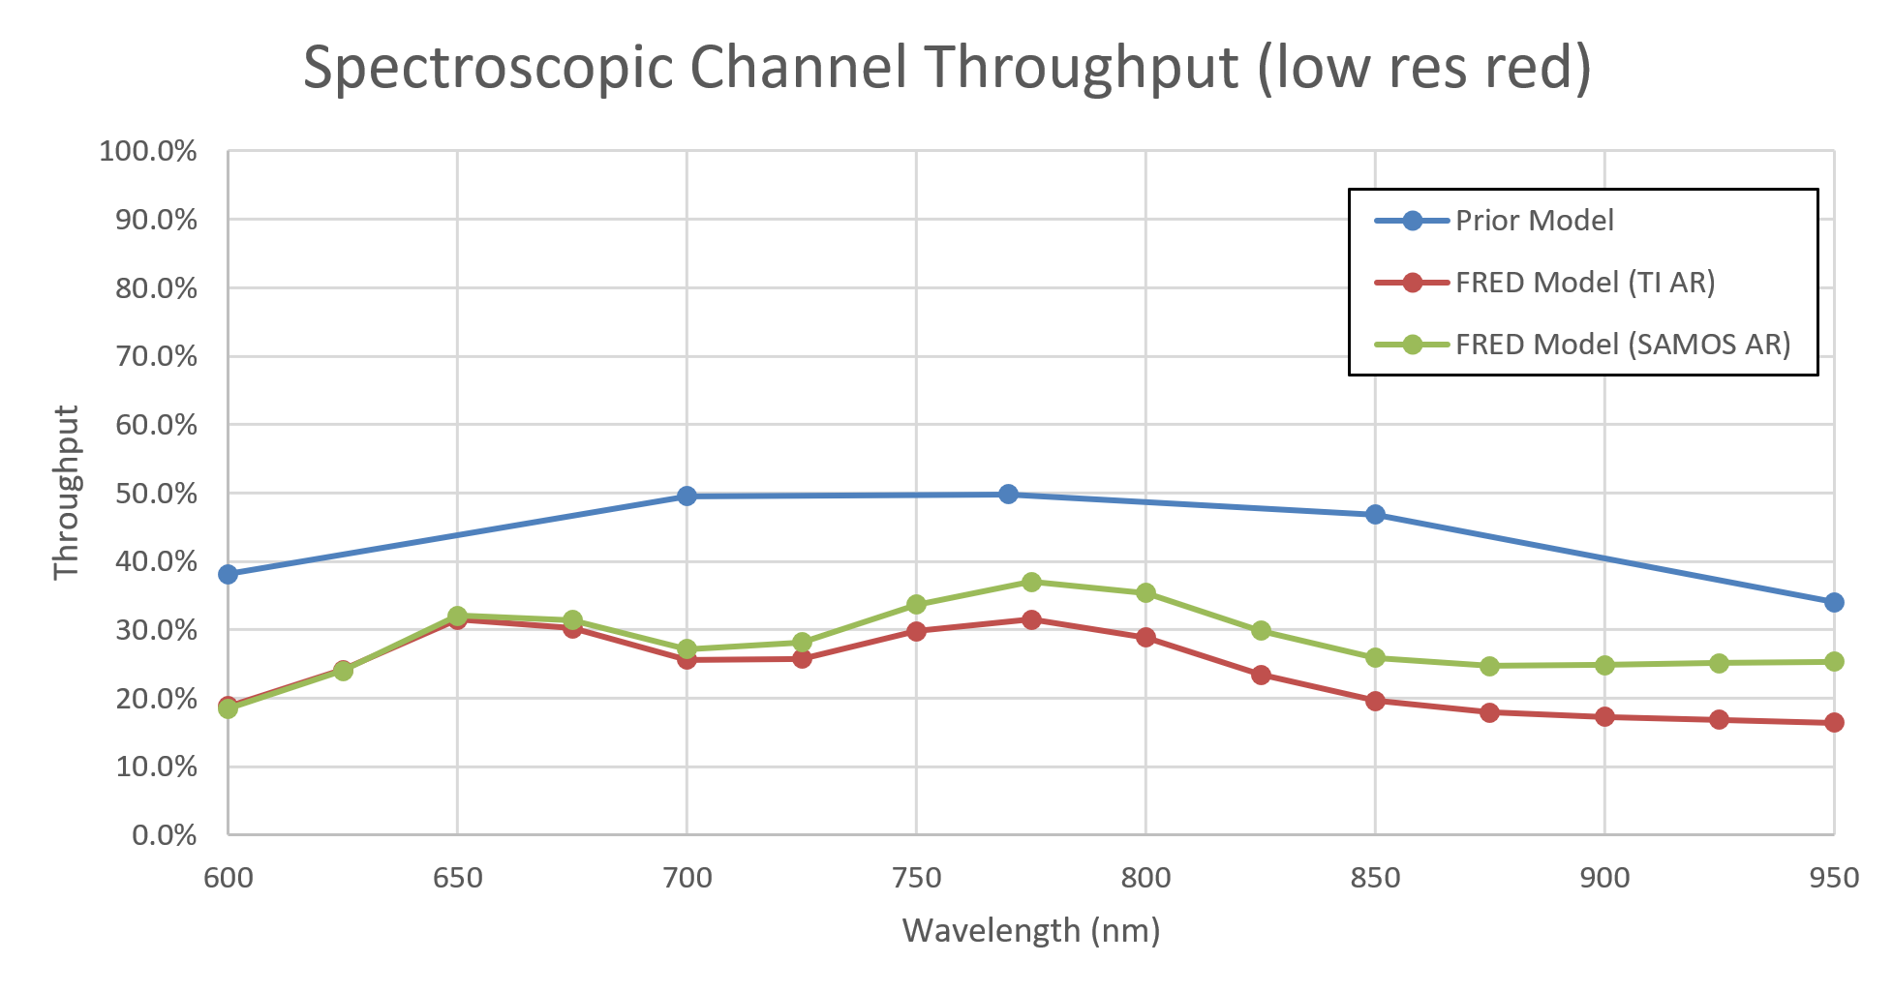
Optical Performance: Predicted Throughput Spectroscopic Channel Low-Res Red
Based on current stock DMD AR coating

Slide 28
Mechanical Performance
Filter wheel operation
Grism exchanger
Flexure

Slide 29
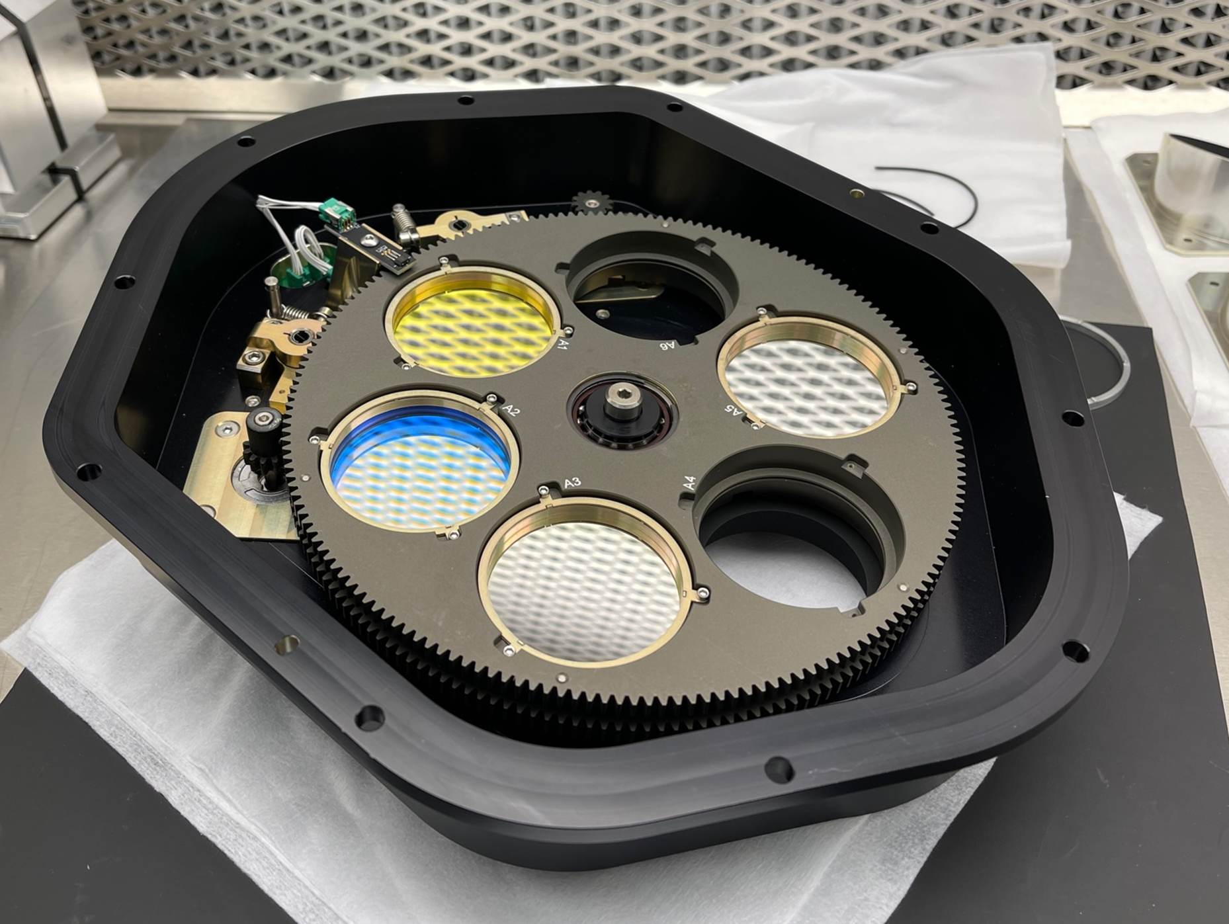
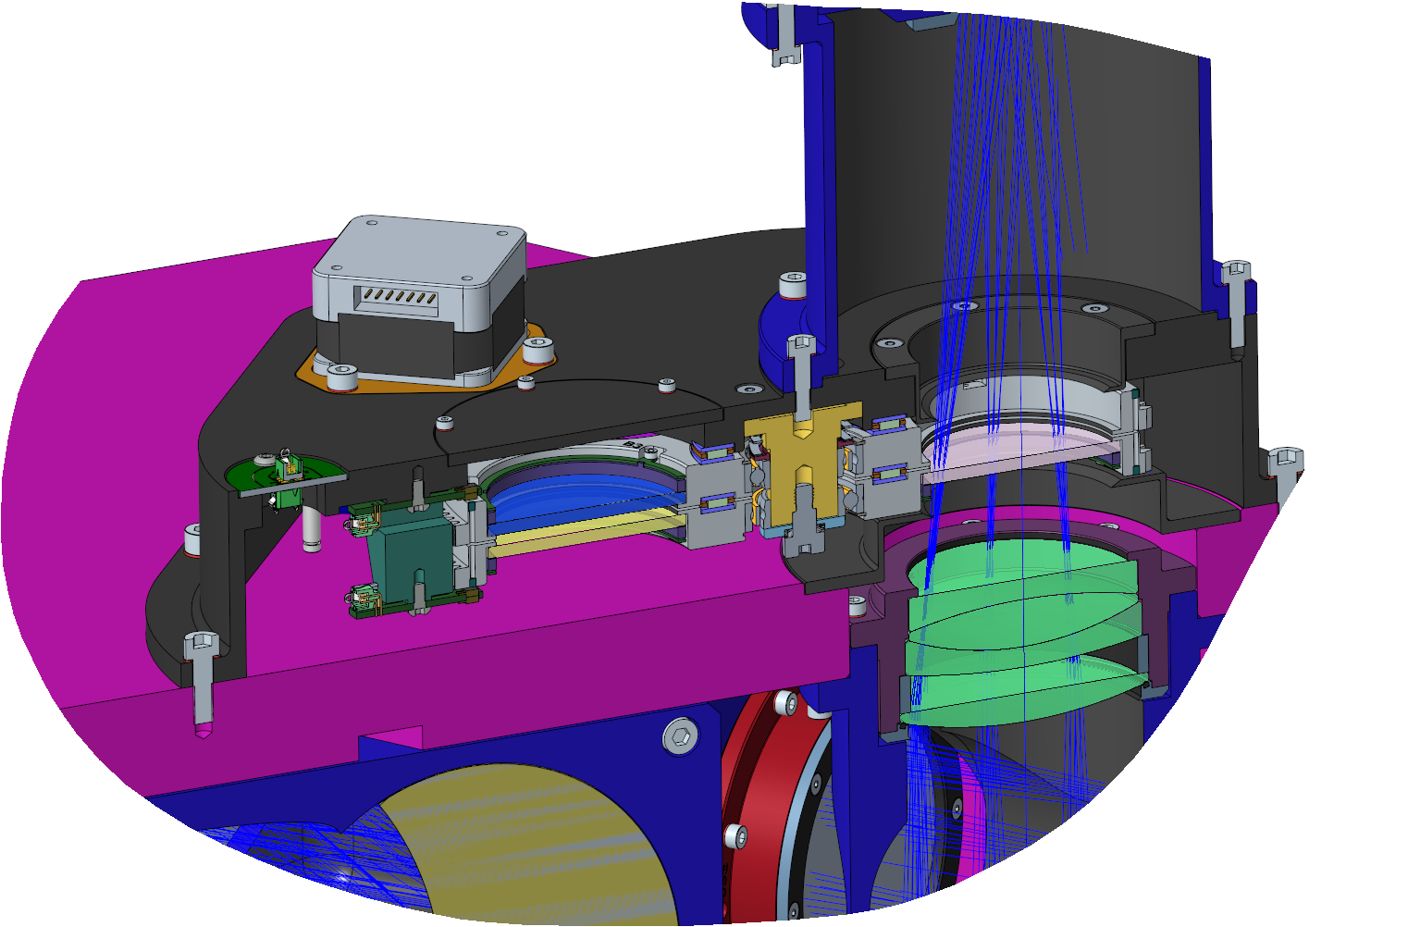
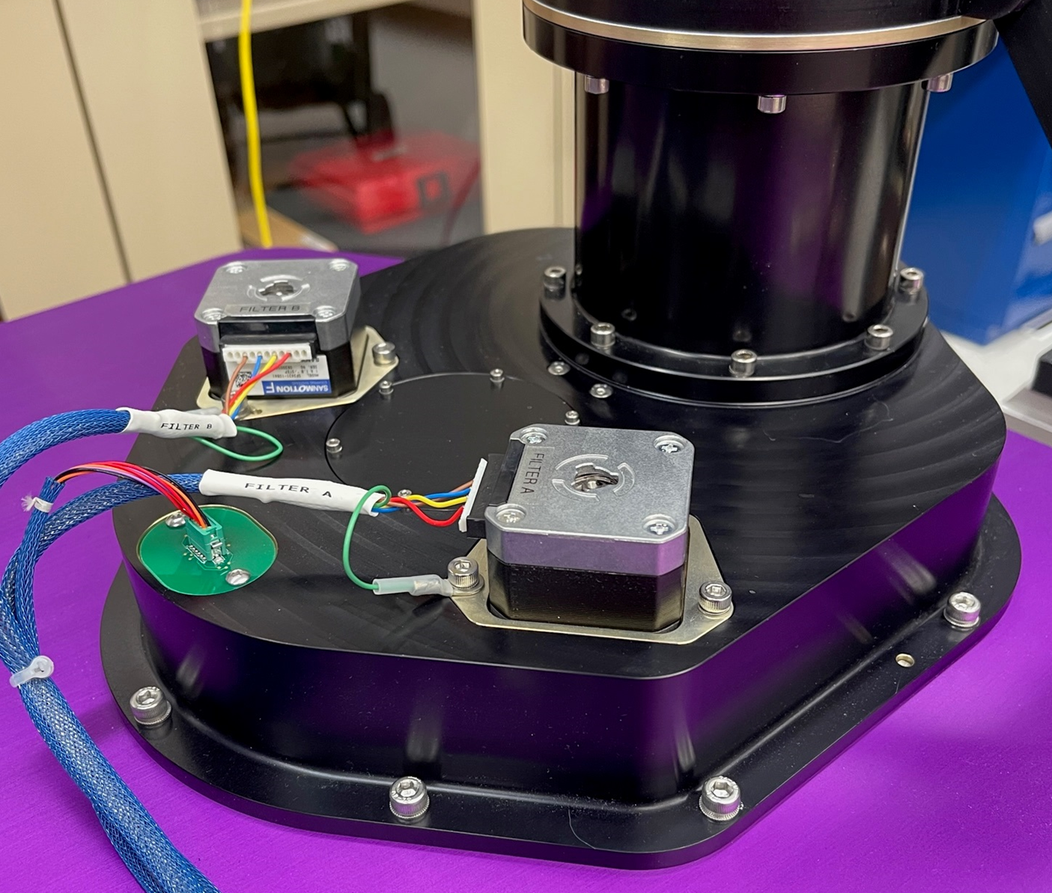
Filter Wheel
Dual wheel design
Six filter holders per wheel
Design heritage: WHIRC, RSS
SAMOS wheels both have been actuated dozens of times during I&T and are robust
Wheel B
Wheel A

Slide 30
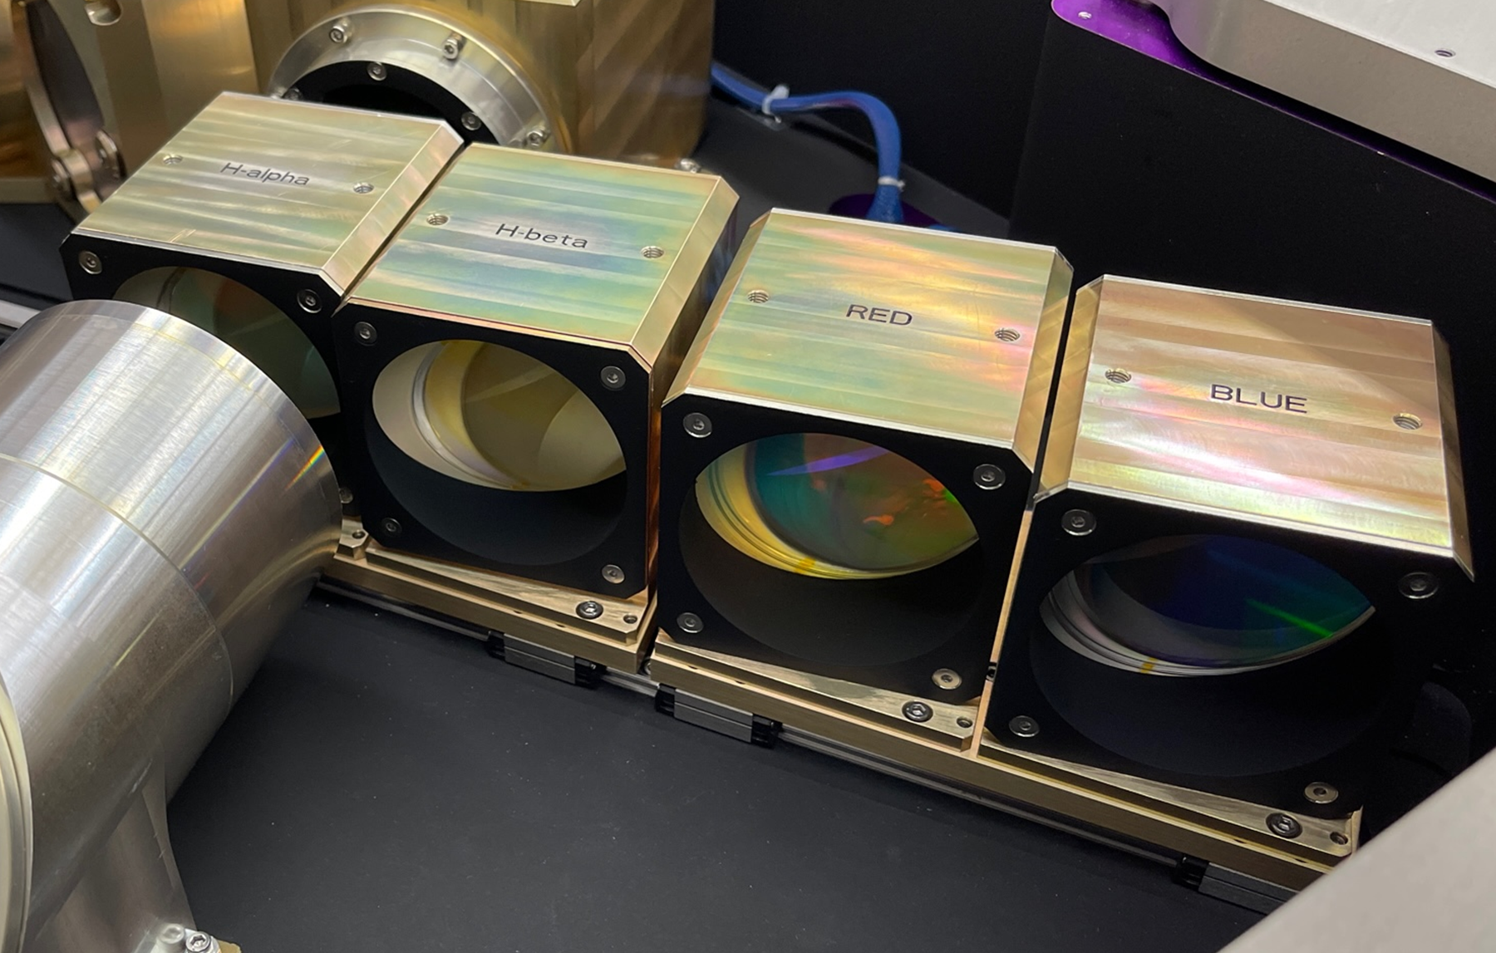
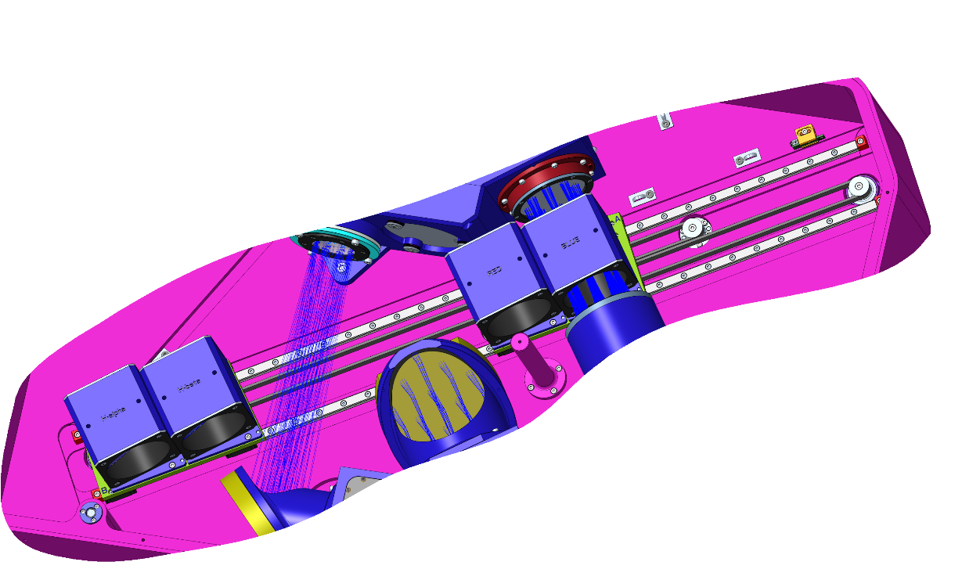
Grism Exchanger
Dual stage, independently driven, belt-drive design
Two grisms per stage: low-res stage and high-res stage
Mechanism shown to be very reliable based on dozens of actuations
Limits and interlocks have passed functional testing
Stage B
High-Res: H-Alpha, H-Beta
Stage A
Low-Res Red and Blue

Slide 31
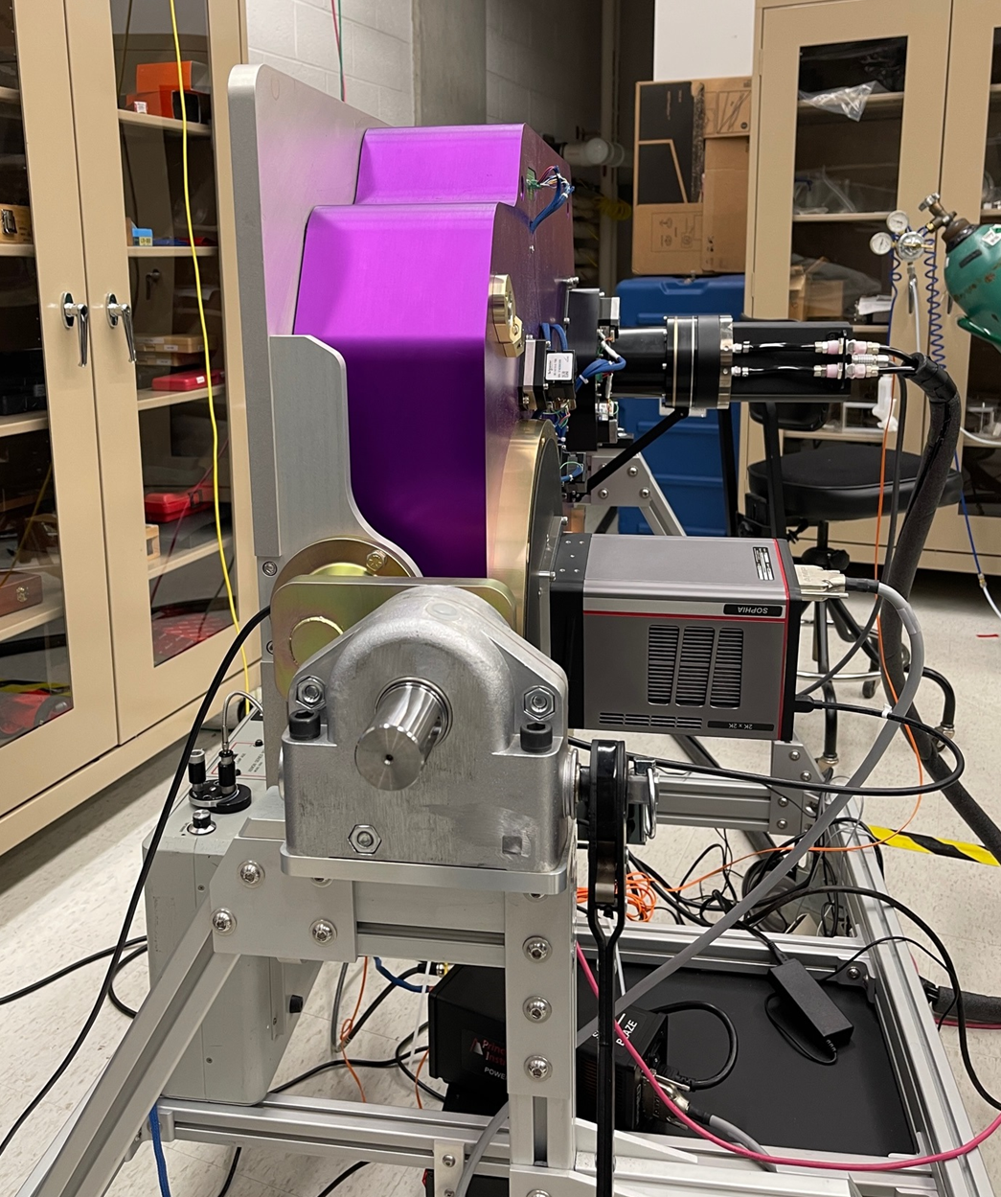
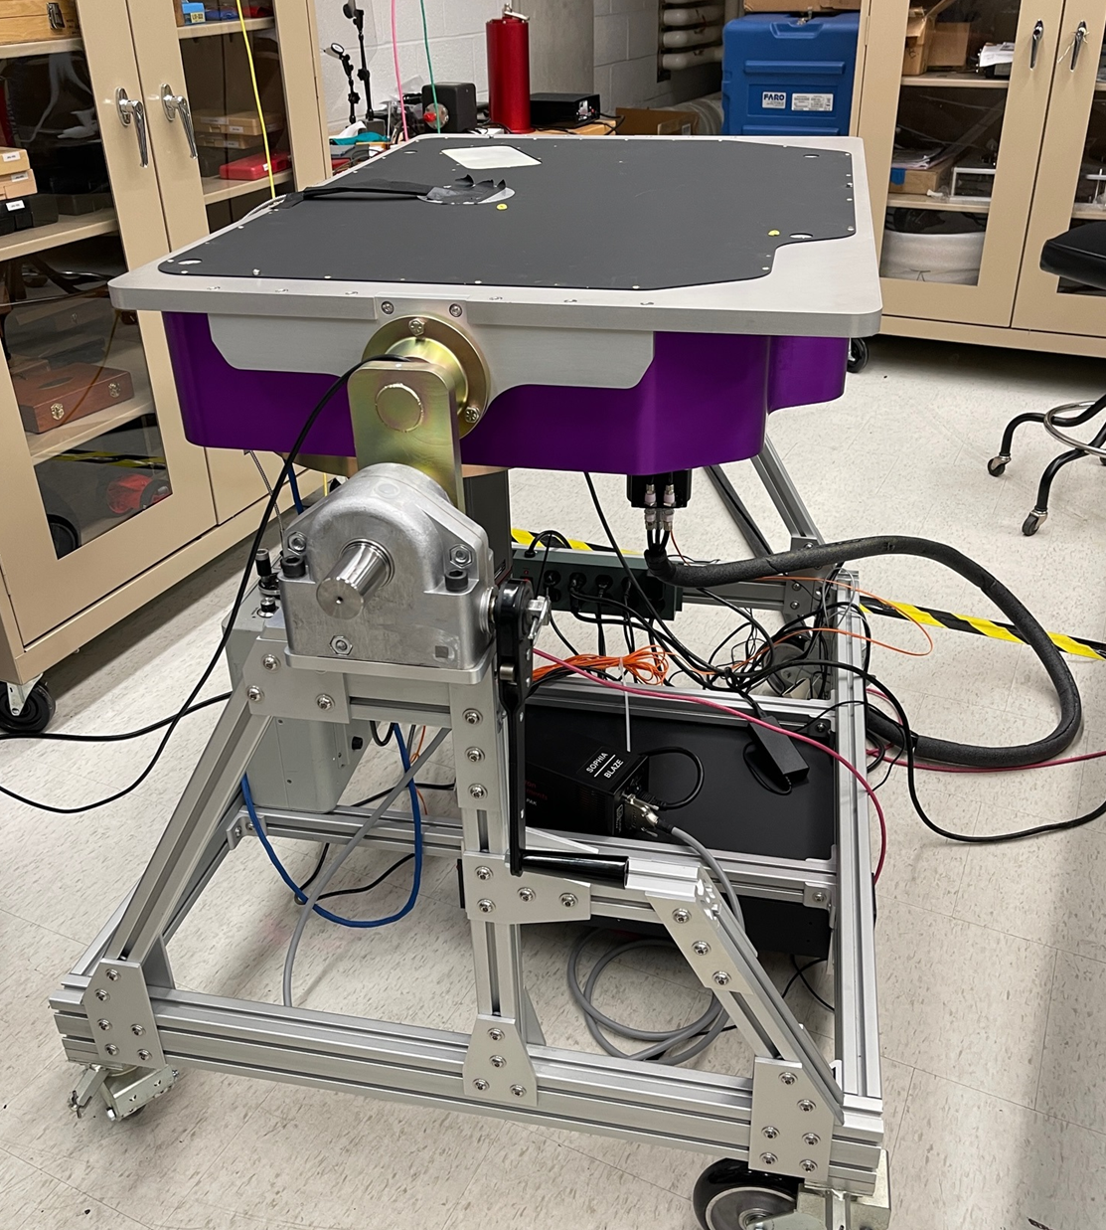
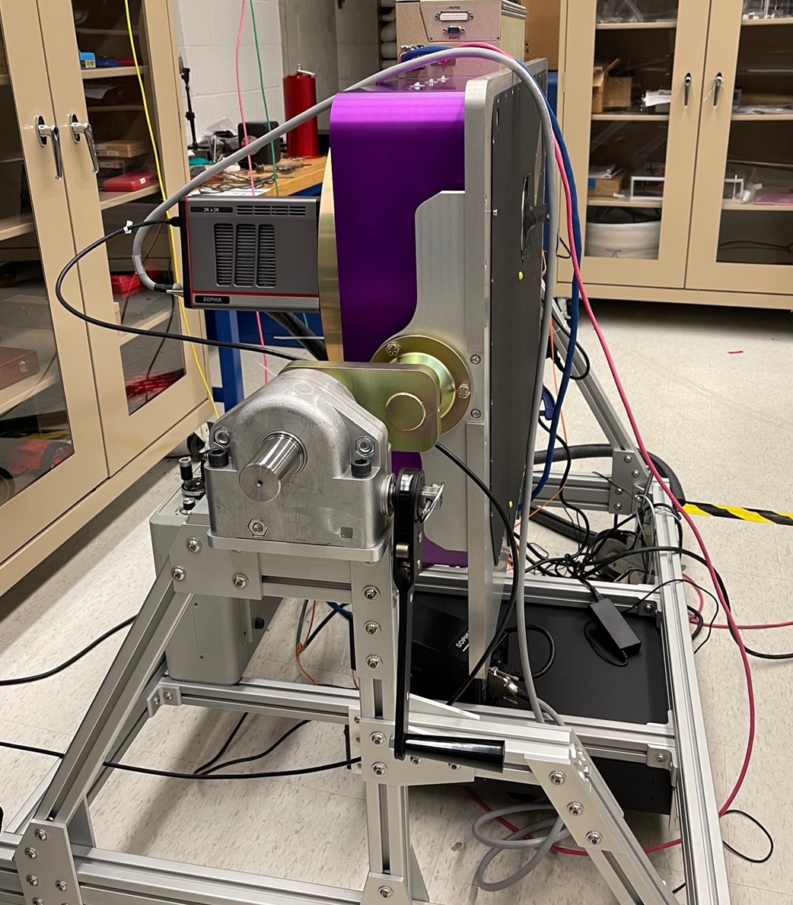
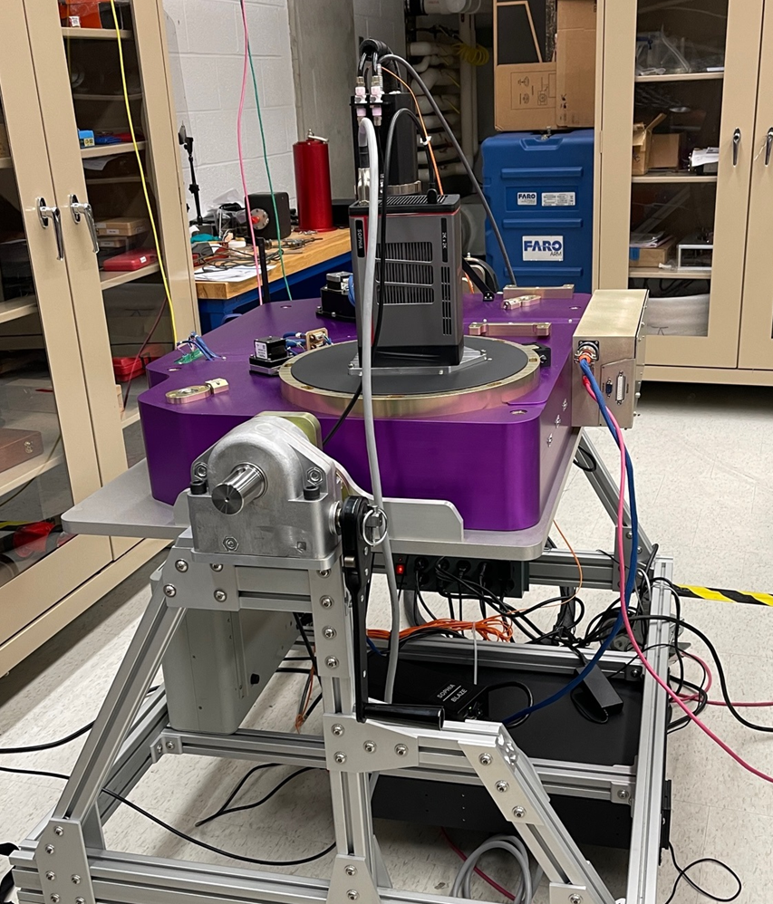
Flexure Measurement
0 deg
90 deg
 | Spectral (Low-Res Red Grism) |  | Imaging
Angle (Deg) | X (Pixel) | Y (Pixel) | X (Pixel) | Y (Pixel)
0 | 1688 | 958 | 526 | 517
90 | 1689 | 957 | 526 | 517
180 | 1689 | 957 | 526 | 517
270 | 1689 | 957 | 526 | 517
180 deg
270 deg

Slide 32
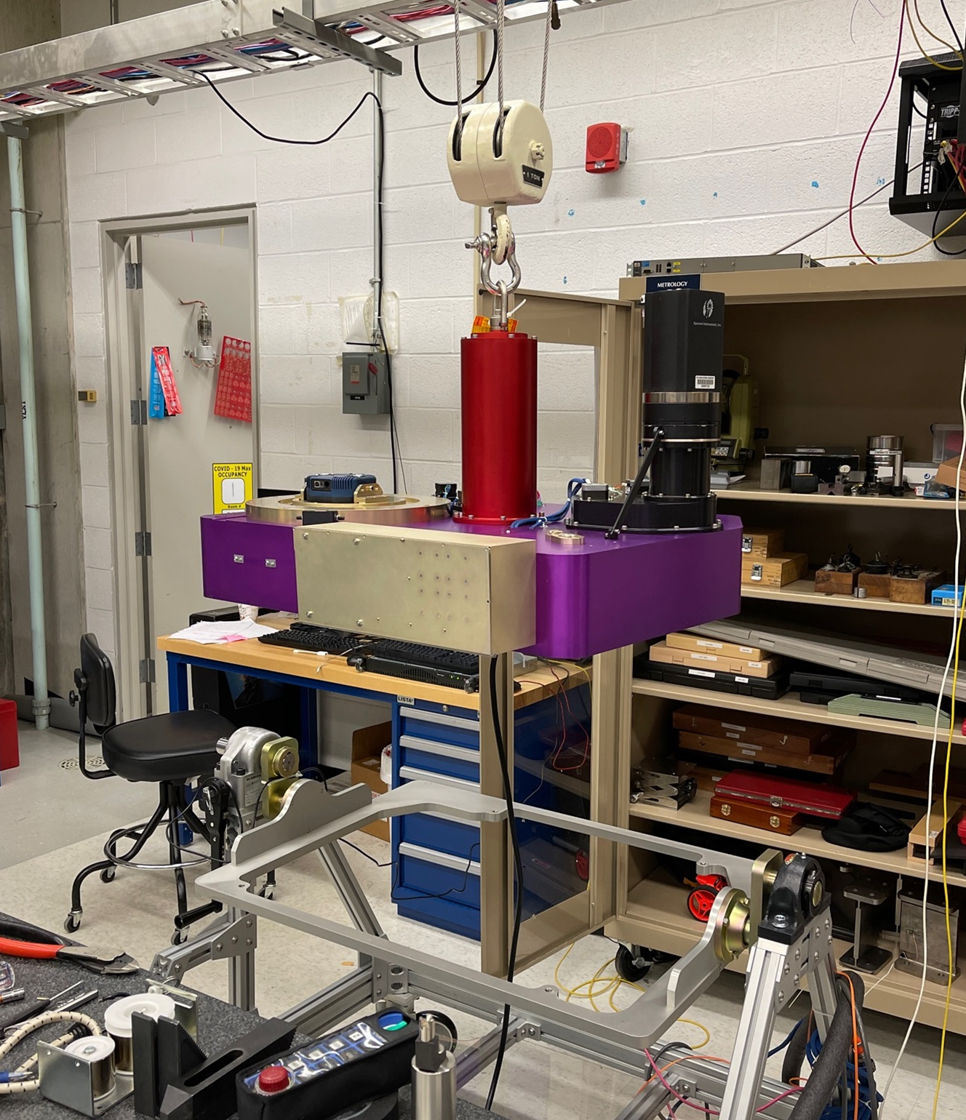
Instrument Handling
Dedicated lift fixture mounts to SAMOS optical bench at the instrument in-plane center of gravity
Hoist ring for crane interface
Balance is adjustable, within limits, to level the instrument when lifted
Instrument is level with SAMI and SAMI electronics removed
SAMOS lift fixture

Slide 33
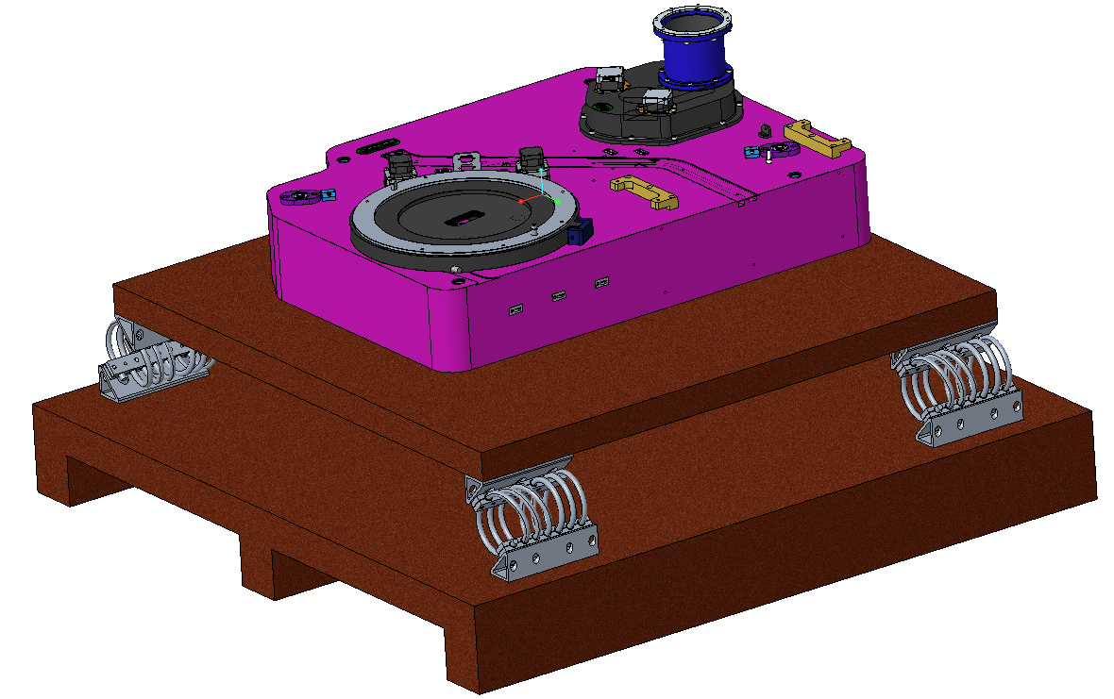
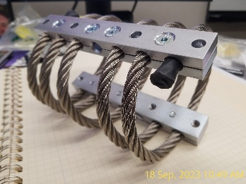
Instrument Shipping Strategy [1 of 2]
Packaging design and packing performed by Craters & Freighters and IDG
Instrument and instrument cart to be shipped in separate crates
Each crate will have a base that allows for pallet jack and forklift use
Instrument will be vapor bagged and boxed in foam
Instrument box to be mounted on a shock and vibration isolated platform
Imaging camera to be removed from the instrument, boxed, and affixed to the same isolation as the instrument.
Isolation Performance Prediction by Socitec:
10cm Drop Shock → 3.0, 5.5, 2.2, g’s in xyz respectively
Random Vibe Response from common carrier PSD (sourced from MIL STD 810H) → 0.7, 0.9, 1.1 grms in xyz respectively.
Vertical (z) natural frequency of 6.5Hz fits with Socitec sensitive equipment target of 5-7Hz.
z
x
Socitec FH40-4405 Isolators
(Worksheet in back-up slides.)
y

Slide 34
Instrument Shipping Strategy [2 of 2]
Shock recorder to be mounted on isolated instrument platform
https://microdaq.com/catalog/product/view/id/3886/s/msr175-shock-temperature-data-logger/category/505/
Shock indicators (G-load TBD) and tilt indicators to be mounted on case
Current plan is to have two crates
Instrument Crate: 1422mm x 1270mm x 1397mm and 213kg (TBF)
Includes SAMOS instrument and separately packed imaging channel camera
Crate 2: 1118mm x 1067mm x 1041mm and 104kg (TBF)
Includes cart, SAMOS electronics chassis, light sources, cables, tools, and miscellaneous items
Photos to be taken of crate internals and exterior prior to leaving JHU

Slide 35
Shipment Plan
Ship end of September
Baltimore to Santiago by air (two quotes pending: C&F and PWS)
Santiago to SOAR by truck (AURA to arrange)
INSURANCE: Anticipate $2.5M of coverage provided by JHU underwriter. Need to confirm that the insurance goes all the way to the summit rather than only to hand-off in Santiago.

Slide 36
Post Shipment Checks [1 of 2] To be performed by SOAR/AURA personnel
Pickup in Santiago
Visually inspect crate exterior for damage
Compare to photos of crates at JHU pre-departure
Check shock indicators
Take photos of exterior (all sides) and shock indicators
Take closeup photos of any fresh damage
Log any discrepancies with the driver and notify JHU through appropriate channels
Send all photos to JHU through appropriate channels
Pickup in La Serena
Visually inspect crate exterior for damage
Compare to photos of crates at Santiago
Check shock indicators
Take photos of exterior (all sides) and shock indicators
Take closeup photos of any fresh damage
Log any discrepancies with the driver and notify JHU through appropriate channels
Send all photos to JHU through appropriate channels

Slide 37
Post Shipment Checks [2 of 2] To be performed by SOAR/AURA personnel
Arrival at SOAR
Visually inspect crate exterior for damage
Compare to photos of crates at JHU pre-departure
Check shock indicators
Take photos of exterior (all sides) and shock indicators
Take closeup photos of any fresh damage
Log any discrepancies with the driver and notify JHU
Send all photos to JHU through appropriate channels
Post arrival (After driver leaves)
Remove lid and inspect internals
Compare condition to photos taken at JHU pre-shipment
Notify JHU of any discrepancies
Replace crate covers
Store containers in a safe location
Take photos to document condition and forward photos to JHU

Slide 38
Pre-Installation Checkout at SOAR [1 of 2] December 2023 Baseline
Unpack crates [1/2 day]
Reproduce instrument lab configuration [1/2 day]
Mount SAMOS on cart (Crane Required: may need crane operator)
Connect electrical cables
Install pinhole projector
Connect light sources
Verify spare cable set functionality
Perform post shipment functional tests [1 day]
Mount SAMI on SAMOS [1 day]
Determine focus shim thickness
Shim and thickness dimension forwarded to machine shop for modification
Mount SAMOS on SAM [1 day]
Verify interface
Shim feet as needed
Return SAMOS to instrument cart

Slide 39
Pre-Installation on SOAR [2 of 2] December 2023 Baseline
Install instrument cables [1 day]
Nasmyth rack to SAMOS
Instrument power cable
Instrument communication cable (Ethernet)
Imging camera power cable
Imaging camera data cable (fiber)
Ethernet from computer room to Nasmyth rack (if needed)
Install glycol lines
SAMOS imaging camera to facility glycol line

Slide 40
Commissioning at SOAR : January – February 2024 1. Installation
Remove SAMOS from cart and mount on SAM
Install SAMI dewar
Install SAMI electronics
Connect instrument cables
Connect glycol lines

Slide 41
Commissioning at SOAR 2. Imaging Channel (SISI)
USING DMD IN FULL FIELD MODE:
Bias, Dark Current and dome flats during the day.
DMD to SISI CCD maps: uses DMD pinholes with dome flats
Telescope focus on camera, PSF check. Encircled energy (initially without SAM closed loop).
Determine best focus of the telescope
Determine image FWHM, Encircled/ensquared flux vs. radius (aperture correction)
at various field position.
Standard stars: determine zero-point, flux calibration in all 8+1 filters
Use Hamuy spectrophotometric standard, see https://noirlab.edu/science/observing-noirlab/observing-ctio/Spectrophotometric-Standards/Hamuy
Astrometric field:
Zero point of rotator for RADEC orientation.
Plate scale, field distortion in all filters.
Repeat to check stability of WCS

Slide 42
Commissioning at SOAR 3. Spectroscopic Channel (SAMI)
Alignment and focus check of SAMI on SAMOS
DMD pinholes with quartz lamp should produce horizontal spectra in all gratings
Bias, Dark Current during the day.
DMD to SAMI CCD maps: uses DMD pinholes with dome flats
Flat field datacube during the day.
Use quartz lamp, for each grating scan long slits by 100pixel steps. Width to be adjusted depending on lamp brightness and exp.time. Analysis script available but to be checked with SAMI data format (Dana)
Dispersion data cube
Same flat field strategy with arc lamp (CuHeAr for blue gratings; HeArNe for red gratings)
Throughput for the four gratings, using spectrophotometric standards
(Hamuy catalog)

Slide 43
Commissioning at SOAR 4. Science Observations in slit mode
Spectroscopy of single star (standard)
Target close to the center of the field
Slit definition
Start imaging and spectroscopic acquisition
Telescope dither move
Adjust slit position, repeat.
Spectroscopy of cluster (NGC3105 or TBD depending on the epoch)
Same procedure as single star using
Pre-defined slits
Slits determined on-the-flight
HTS: cycle through a Hadamard datacube on compact target (TBD)

Slide 44
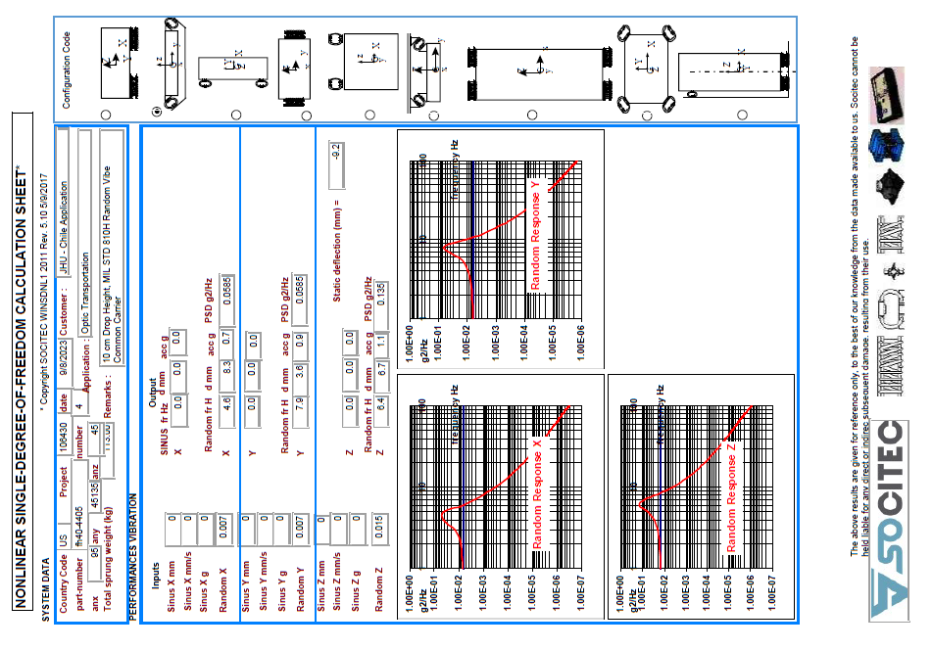
BACK UP
Wire Rope Isolator Spec Worksheet p1/2

Slide 45
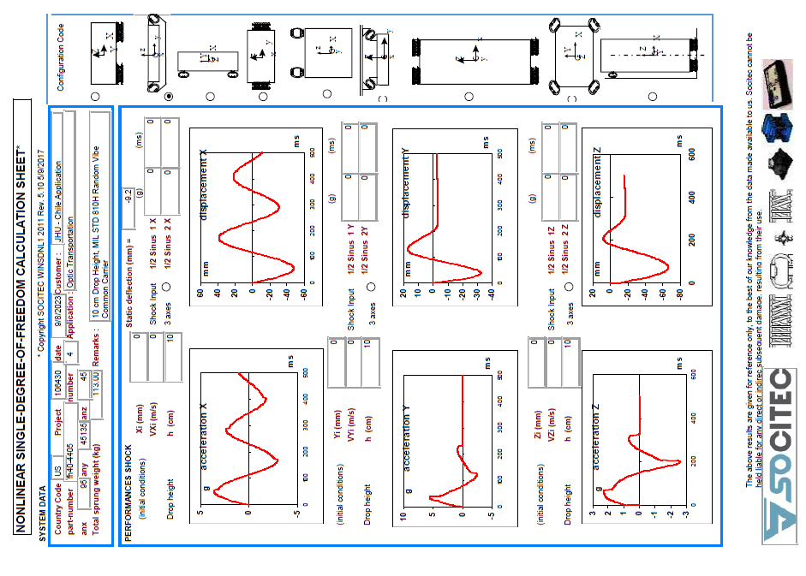
BACK UP
Wire Rope Isolator Spec Worksheet p2/2

